Slide 1
UNIT 5: CONVECTION HEAT TRANSFER
LEARNING OBJECTIVES
After studying this unit you should be able to:
Distinguish between natural and forced convection heat flows.
Determine the convective heat transfer coefficient in forced and natural convection for external and internal flows.
Work with convective heat transfer coefficient in heat exchanger problem analysis.
UNIT CONTENT
SESSION 1-5: Introduction to Convection Heat Transfer
Forced Convection
SESSION 2-5: Natural Convection
Combined Effects of Forced and Natural Convection

Slide 2
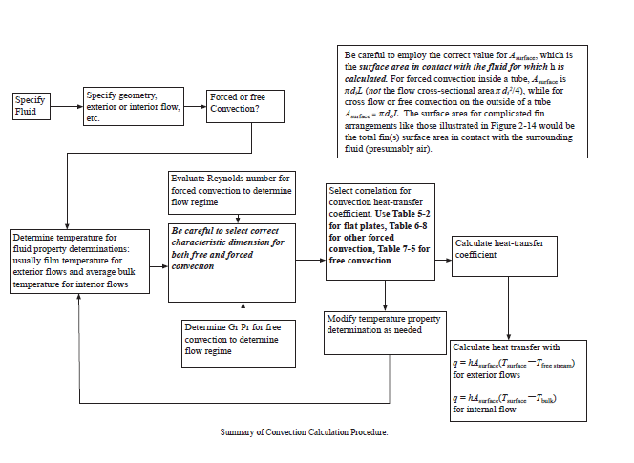
Summary of Convection Calculation Procedure

Slide 3
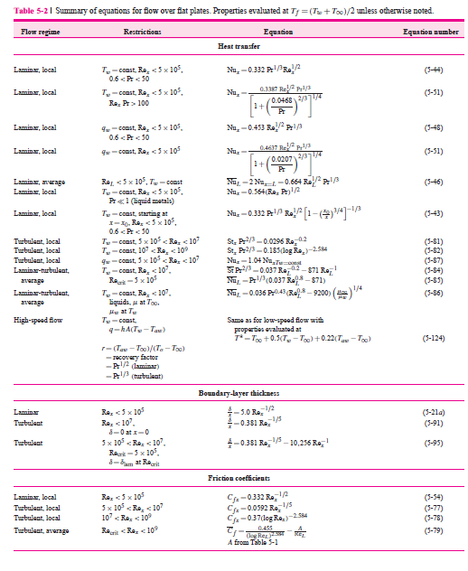
Forced Convection heat transfer correlations over flat plates

Slide 4
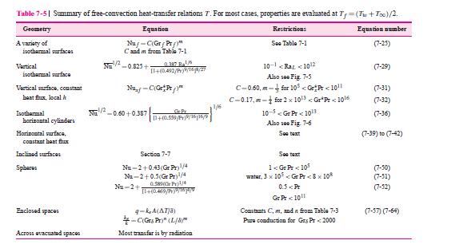
Summary of Correlations for free convection heat transfer coefficient

Slide 5
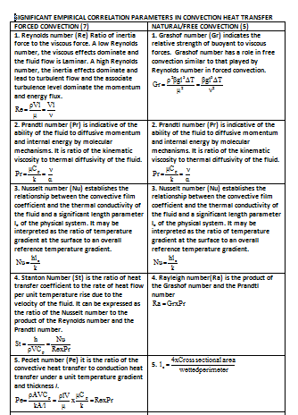
SUMMARY OF CORRELATION PARAMETERS IN CONVECTION HEAT TRANSFER

Slide 6
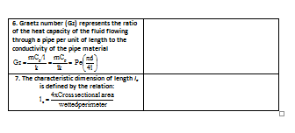
Contd.

Slide 7
SESSION 1-5: INTRODUCTION TO CONVECTION HEAT TRANSFER
Methods of Calculating Rate of Convection Heat Transfer Contd.
2. The second method studies the behaviour of the boundary layer. It makes use of the similarity, first pointed out by Reynolds, between the mechanism of fluid friction in the boundary layer (i.e. the transfer of fluid momentum to the wall) and the transfer of heat by convection. When this analogy is valid, rates of heat transfer can be predicted from the measurement of the shear stress between a fluid and a wall.
3. The third method is concerned with model testing, used to obtain information in a form, which is applicable to similar systems of any scale. It is based on the principle of dynamic similarity, and employs the method of dimensional analysis for the correlation of empirical data. It was pointed out in chapter 1 that it is customary in engineering to express the rate of heat transfer between a fluid and a wall by a relation of the form
Where h is a convection or film heat transfer coefficient.
Note that α is not a physical constant of the fluid. α is a function of all the parameters that affect the heat flow, such as viscosity and velocity, and it may even depend on A and (T_{s}- T_{w} ) because Q does not necessarily vary with these variables.

Slide 8
SESSION 1-5.1: FORCED CONVECTION
The study of forced convection is concerned with the transfer of heat between a moving fluid and a solid surface.
To apply Newton's law of cooling,
Find a value for the convection heat transfer coefficient, α which is given by k/δ, where k is the thermal conductivity of the fluid and δ is the thickness of the fluid film on the surface.
The value of δ is found in terms of the fluid properties and the fluid velocity; as well as the type of fluid flow across the surface and is governed by the Reynolds number.
Reynolds number
The Reynolds number is dimensionless group given by ;
where ρ is the fluid density, u is the fluid mean velocity, L is the characteristic linear dimension, μ is the dynamic viscosity of the f1uid, and ν is the kinematic viscosity of the fluid.

Slide 9
SESSION 1-5.1: FORCED CONVECTION
Reynolds number
It represents the ratio of the inertia forces to viscous forces in the fluid.
At large Reynolds numbers, the inertia forces, which are proportional to the density and the velocity of the fluid, are large relative to the viscous forces, and thus the viscous forces cannot prevent the random and rapid fluctuation of the fluid.
At small Reynolds numbers, however, the viscous forces are large enough to overcome the inertia forces to keep the fluid “in line.” Thus, the flow is turbulent in the first case and laminar in the second.
The Reynolds number at which the flow becomes turbulent is called the critical Reynolds number.
For flow over a flat plate, transition from laminar to turbulent occurs at the critical Reynolds number
This generally accepted value of the critical Reynolds number, for a flat plate, may vary somewhat depending on the surface roughness, the turbulence level, and the variation of pressure along the surface.

Slide 10
SESSION 1-5.1: FORCED CONVECTION
Note:
The various kinds of forced convection, such as flow in a tube, flows across a tube, flows across a flat plate, etc. can be solved mathematically when certain assumptions are made with regard to the boundary conditions.
It is exceedingly difficult to obtain an exact mathematical solution to such problems, particularly in the case of turbulent flow, but approximate solutions can be obtained by making suitable assumptions.
It is not within the scope of this course to approach the subject of forced convection fundamentally. However, many of the results used in heat transfer are derived from experiment, and in fact for many problems no mathematical solution is available and empirical values are essential.
These empirical values can be generalised using dimensional analysis, which will now be considered.

Slide 11
SESSION 1-5.2: DIMENSIONAL ANALYSIS
Note:
In order to apply dimensional analysis, it is necessary to know from experience all the variables upon which the desired function depends. Since the results must apply to geometrically similar bodies therefore one of the variables must always be a characteristic linear dimension.
Analysis:
It is found that the heat transfer coefficient,α , depends on the fluid viscosity,μ , the fluid density,ρ , the thermal conductivity of the fluid,λ , the specific heat capacity of the fluid, c, the temperature difference between the surface and the fluid ,Δt and the fluid velocity, u. Therefore we have;
Hence;
Dimensions of α = dimensions of
Each of the properties in the equation above can be expressed in terms of five fundamental dimensions; these are mass, M, length, L, time, T, temperature, t, and heat H.

Slide 12
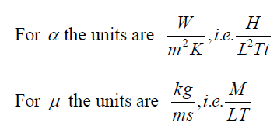
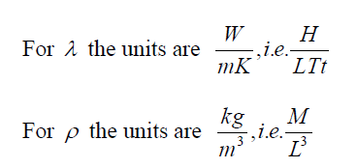
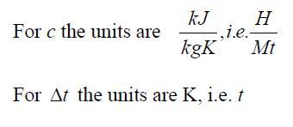
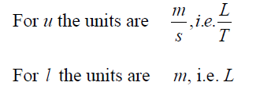
SESSION 1-5.2: DIMENSIONAL ANALYSIS
Note:
For dimensions of each side of the equation to be the same, the power to which each fundamental dimension is raised must be the same on both sides of the equation.
Substituting these values into the above equation and equating the indices, it can be seen that;

Slide 13
SESSION 1-5.2: DIMENSIONAL ANALYSIS
Note:
The dimensionless group, hl/k is called the Nusselt number, Nu;
The dimensionless group, cμ/k is called the Prandtl number, Pr;
The dimensionless group,ρul/μ is called the Reynolds number, Re;
Thus
Experiments can be performed in order to evaluate K, and to determine the nature of the function F.
When evaluating Nu, Pr and Re it is customary to take the fluid properties at a suitable mean temperature, since the properties vary with temperature. For cases in which the temperature of the bulk of the fluid is not different from the temperature of the solid surface, then fluid properties are evaluated at the mean bulk temperature of the fluid.
When the temperature difference is large, using a mean bulk temperature may cause errors, and a mean film temperature is sometimes used;

Slide 14
SESSION 1-5.3: REYNOLDS ANALOGY
Reynolds postulated that the heat transfer from a solid surface is similar to the transfer of fluid momentum from the surface, and hence that it is possible to express the heat transfer in terms of the frictional resistance to the flow.
Analogy:
Consider turbulent flow. It can be assumed that particles of mass, m, transport heat and momentum to and from the surface, moving perpendicular to the surface. Then, on the average ,Heat transfer per unit area is given by:
(5.6)
Also, the rate of change of momentum across the stream is given by ;
(5.7)
The shear stress in the fluid at the wall (force per unit area) τ_{w} is given by
(5.8)
Combining equations 5.6 and 5.8 gives;
(5.9)

Slide 15
SESSION 1-5.3: REYNOLDS ANALOGY
Analogy:
For a turbulent flow, in practice there is always a thin layer of fluid on the surface in which viscous effects predominate. This film is known as the laminar sub-layer.
It can be shown that; which is identical to equation (5.9)
Where c = k/μ that is when or Pr = 1
Therefore, for fluids whose Prandtl number is approximately unity the simple Reynolds analogy can be applied, since the heat transferred across the laminar sub-layer can be considered in a similar way to the heat transferred from the sub-layer to the bulk of the fluid. For most gases, dry vapours, and superheated vapour Pr lies between about 0.65 and 1.2.
A dimensionless friction factor, f, is defined by;

Slide 16

SESSION 1-5.3: REYNOLDS ANALOGY
The Stanton Number, St is expressed as;
For flow in a pipe of diameter, d, the resistance to flow over unit length is given by;
The ratio of the pumping power required to the rate of heat flow can be expressed as:
The above equation suggests that the power required for a given heat transfer rate can be reduced by decreasing the velocity of flow, u. However, a reduction in the fluid velocity means that the required surface area must be increased, and hence a compromise must be made.

Slide 17
Worked Example 5.1 : Heating of air in a tube
Question:
Air is heated by passing it through a 25 mm bore copper tube which is maintained at 280 ºC. The air enters at 15 ºC and leaves at 270 ºC at a mean velocity of 30 m/s. Using the Reynolds analogy, calculate the length of the tube and the pumping power required. For turbulent flow in a tube take ,
and all properties at mean film temperature. Take the mean temperature difference as .
Solution
The mean film temperature can be found as:
Properties
From Table 10 at t_{f} = 211.25ºC = 484.4 K, the properties of air can be found as:
λ = 3.938 x10⁻⁵ kW/m K; Pr = 0.681; ν = 3.591 x 10⁻⁵ m²/s; ρ = 0.73 kg/m³;
c_{p} = 1.027 kJ/kg.K

Slide 18
Worked Example 5.1 : Heating of air in a tube
Analysis:
Then:
Therefore,
That is;

Slide 19
Worked Example 5.1 : Heating of air in a tube
Analysis:
Hence,
Also,
Then,
Therefore,
That is, Pumping power = 31.7 W

Slide 20
SESSION 1-5.4: The Heat Transfer Coefficient
Churchill and Bernstein presented a relation for the determination of the average Nusselt number for flow over a cylinder:
(5.18)
The fluid properties are evaluated at the film temperature ,which is the average of the free-stream and surface temperatures.
For flow over a sphere, Whitaker proposed the following comprehensive correlation:
(5.19)
which is valid for 3.5 ≤ Re ≤ 80,000 and 0.7 ≤ Pr ≤ 380. The fluid properties in this case are evaluated at the free-stream temperature ,T∞ except for , μ_{s} which is evaluated at the surface temperature, T_{s}. Although the two relations above are considered to be quite accurate, the results obtained from them can be off by as much as 30 percent.

Slide 21
SESSION 1-5.4: The Heat Transfer Coefficient
The average Nusselt number for flow across cylinders can be expressed compactly as;
(5.20)
Where, n = 1/3 and the experimentally determined constants C and m are given in Table 9 for circular as well as various noncircular cylinders. The characteristic length D for use in the calculation of the Reynolds and Nusselt numbers for different geometries is as indicated on the figure.
Note that all fluid properties are evaluated at the film temperature
The relations for cylinders as presented are for single cylinders or cylinders oriented such that the flow over them is not affected by the presence of others. Also they are applicable to smooth surfaces only. Surface roughness and free-stream turbulence may affect the drag and heat transfer coefficients significantly.

Slide 22
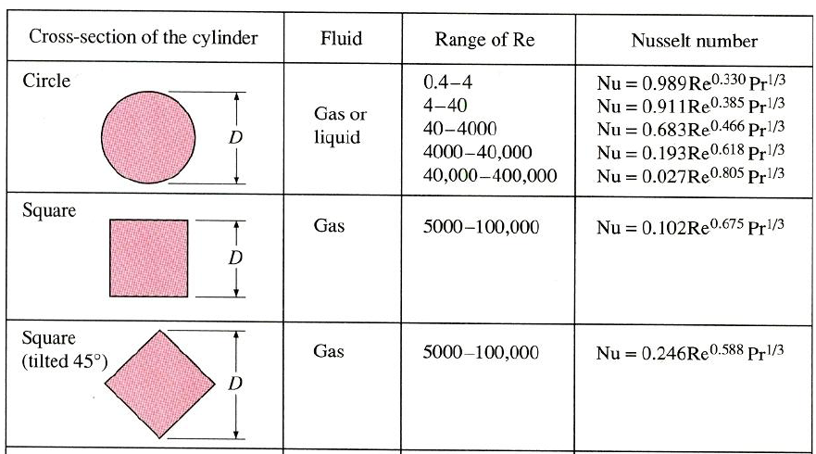
SESSION 1-5.4: The Heat Transfer Coefficient
Table 9: Empirical correlations for the average Nusselt number for forced convection over circular and non-circular cylinders in cross flow (from Zhukauskas and Jacob) (Refer to Page 153 for other cross sections)

Slide 23
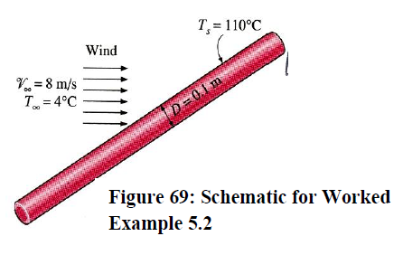
Worked Example 5.2 : Heat Loss from a Steam Pipe in Windy Air
Question:
A long 10-cm diameter steam pipe whose external surface temperature is 110 ºC passes through some open area that is not protected against the winds. Determine the rate of heat loss from the pipe per unit of its length when the air is at 1 atm pressure and 4 ºC and the wind is blowing across the pipe at a velocity of 8 m/s.

Slide 24
Worked Example 5.2 : Heat Loss from a Steam Pipe in Windy Air
Solution:
Assumptions: (1) Steady operating conditions exist. (2) Radiation effects are negligible. (3) Air is an ideal gas (4) Pressure is 1 atm
Properties: The properties of air at the film temperature of 330K (Table 10);
λ = 0.0283 W/mºC Pr = 0.708 ν = 1.86 x 10⁻⁵m²/s
Analysis: This is an external flow problem, since we are interested in the heat transfer from the pipe to the air that is flowing outside the pipe. The Reynolds number of the flow is;
Then the Nusselt number in this case can be determined from;

Slide 25
Worked Example 5.2 : Heat Loss from a Steam Pipe in Windy Air
Solution:
And
Then the rate of heat transfer from the pipe per unit of its length becomes;
The rate of heat loss from the entire pipe can be obtained by multiplying the value above by the length of the pipe in m.
Discussion: The simpler Nusselt number relation in Table 9 in this case would give Nu = 129, which is 34 percent lower than the value obtained above using Equation 5.18

Slide 26
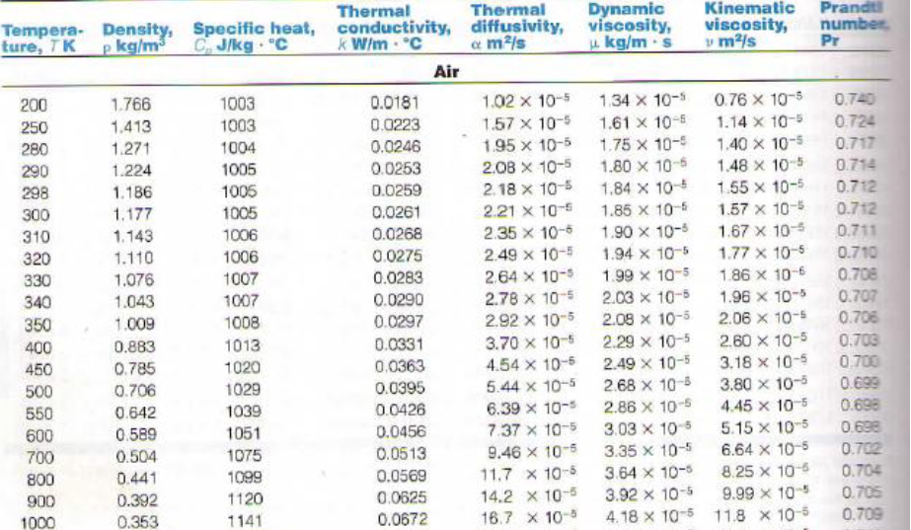
Table 10: Properties of Gases at 1atm Pressure
Note: Refer to page 156 for other gas properties

Slide 27
SESSION 2-5: NATURAL CONVECTION
Natural or free convection heat transfer is due to differences in density in the fluid causing a natural circulation, and hence a transfer of heat.
The superimposed effect of natural convection is small enough to be neglected for most problems in which a fluid flows across a surface.
In the absence of a forced velocity of the fluid and neglecting radiation heat transfer, then the mode of heat transfer in the fluid is entirely by natural or free convection.
The heat transfer in this case depends on the coefficient of cubical expansion (volume expansion coefficient), β, which is given by;
Δt = temperature difference between the two parts of the fluid of density ρ₁ and ρ₂

Slide 28

Analysis of Natural convection Heat Transfer
The volume expansion coefficient β of an ideal gas at an absolute temperature T is equivalent to the inverse of the temperature;
The up thrust per unit volume of fluid is: ,and the velocity of the
convection current is dependent on the up thrust. That is the convection currents depends on;
The heat transfer also depends on the fluid viscosity, thermal conductivity of the fluid, and a characteristic dimension of length.
NOTE:
Since the coefficient of cubical expansion and the local acceleration due to gravity, do not have a separate effect on the heat transfer, then only the product,
needs to be considered.

Slide 29
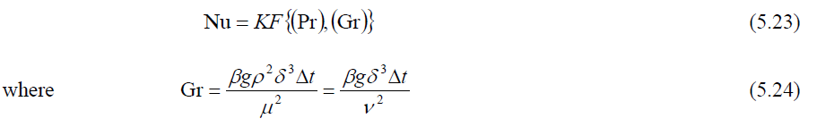
Dimensional Analysis of Natural Convection Heat Transfer
From the procedure of dimensional analysis, we obtain:
Gr = Grashof number, δ = characteristic length of the geometry, μ = dynamic viscosity and ν = kinematic viscosity of the fluid.
Note:
For Natural convection heat transfer, the Nusselt number, Nu is a function of the Grashof number, Gr and the Prandtl number, Pr.
For forced convection heat transfer, the Nusselt number, Nu is a function of the Reynolds number, Re and the Prandtl number, Pr.
In many cases of natural convection, it is possible to use an approximate equation to evaluate the heat transfer coefficient.

Slide 30
The Grashof Number
It represents the ratio of the buoyancy force to the viscous force acting on a fluid.
The role played by the Reynolds number in forced convection is played by the Grashof number in natural convection.
It provides the main criterion in determining whether the fluid flow is laminar or turbulent in natural convection.
The flow regime on a vertical plate becomes turbulent at Grashof numbers greater than 10⁹.
Thus for laminar flow on a vertical plate, Gr < 10⁹ and that for turbulent flow on a vertical plate, Gr > 10⁹
From Newton’s law of cooling;
Where, A = heat transfer surface area
α = Average heat transfer coefficient on the surface

Slide 31


2-5.1 : Natural Convection Correlations
The simple empirical correlations for the average Nusselt number , Nu in natural convection are of the form;
Ra = Rayleigh number
Note:
The values of the constants C and n depend on the geometry of the surface and the flow regime, which is characterised by the range of the Rayleigh number. The value of n is usually 1/4 for laminar flow and 1/3 for turbulent flow. The value of the constant C is normally less < 1.

Slide 32
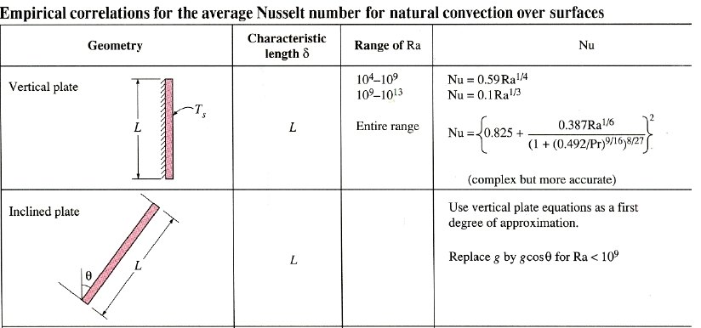
Natural convection correlation contd.
Simple relations for the average Nusselt number for various geometries are given in Table 11, together with sketches of the geometries.. All fluid properties are to be evaluated at the film temperature
Table 11

Slide 33
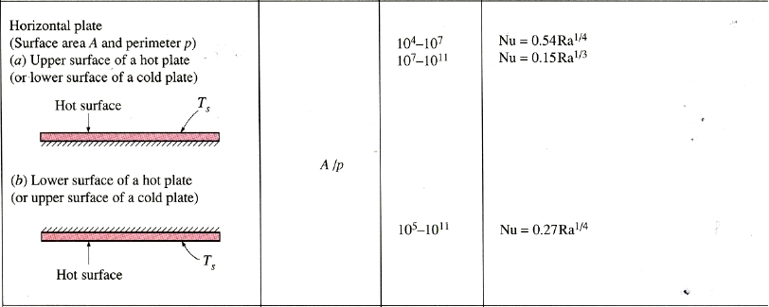
Natural convection correlation contd.
Table 11 continued ; Empirical correlations for average Nusselt number for natural convection over surfaces

Slide 34
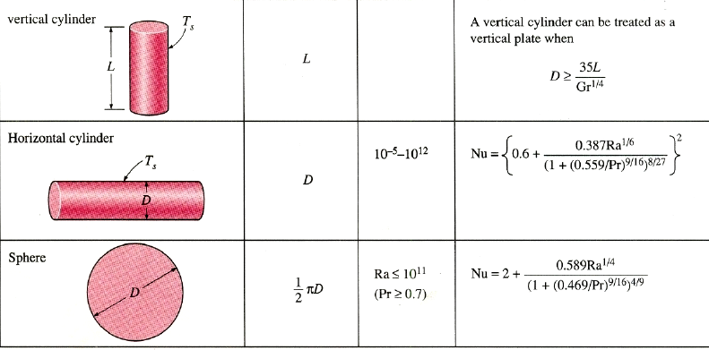
Natural convection correlation contd.
Table 11 continued ; Empirical correlations for average Nusselt number for natural convection over surfaces

Slide 35
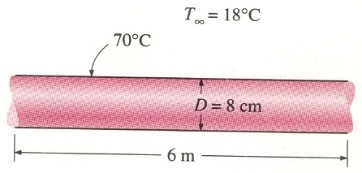
Worked Example 5.3 : Heat loss from Hot Water Pipes
Question:
A 6-m-long section of an 8-cm-diameter horizontal hot water pipe shown in Figure 70 below passes through a large room whose temperature is 18ºC. If the outer surface temperature of the pipe is 70ºC, determine the rate of heat loss from the pipe by natural convection.
Figure 70
Solution: A horizontal hot water pipe passes through a large room. The rate of heat loss from the pipe by natural convection is to be determined.

Slide 36
Solution Worked Example 5.3 Contd.
Assumptions:
(1) Steady operating conditions exist.
(2) Air is an ideal gas.
(3) The local atmospheric pressure is 1 atm.
Properties: The properties of air at the film temperature of
λ = 0.0273 W/mºC Pr = 0.710 ν = 1.74 x 10⁻⁵m²/s
β = 1/T_{f} = 1/317 K = 0.00315 K⁻¹
Analysis:
The characteristic length in this case is the outer diameter of the pipe, δ = D = 0.08m Then, the Rayleigh number becomes:

Slide 37
Solution Worked Example 5.3 End.
Then, the natural convection Nusselt number in this case can be determined from the appropriate equation from Table 11 to be:
Then

Slide 38
Worked Example 5.4 : Heat loss from a Wall
Question:
A wall 0.6 m high by 3 m wide is maintained at 79 ºC in an atmosphere at 15 ºC. Neglecting end effects and radiation, calculate the rate of heat loss by natural convection. For natural convection from a vertical flat surface take, at any distance, x:
Where all properties are at the mean film temperature, and β = 1/T, where T is the absolute temperature of the bulk of the air.
Solution: The rate of heat loss from a wall by natural convection is to be determined given specified conditions and expressions for the local Nusselt number.

Slide 39
Solution Worked Example 5.4 Contd.
Assumptions:
(1) Steady operating conditions exist.
(2) Air is an ideal gas.
(3) The local atmospheric pressure is 1 atm.
Properties: The properties of air at the film temperature of
λ = 0.02778 W/mºC Pr = 0.7022 ν = 1.759 x 10⁻⁵m²/s
But β = 1/T∞ = 1/288 K = 0.00347 K⁻¹ ,where T∞ is the bulk air temperature.
Analysis: The characteristic length in this case is the outer height of the wall, δ = H = 0.6 m.

Slide 40
Solution Worked Example 5.4 Contd.
Then, the Grashof number becomes:
Gr < 10¹⁰ hence,
Therefore, the heat transfer coefficient α is:

Slide 41
Solution Worked Example 5.4 End
Heat loss by convection can be determined from Newton’s Law of Cooling as:

Slide 42

2-5.2 : Natural Convection inside Enclosures
The Rayleigh number for an enclosure is determined from
Where, the characteristic length δ is the distance between the hot and cold surfaces, and T₁ and T₂ are the temperatures of the hot and cold surfaces, respectively.
Note:
All fluid properties are to be evaluated at the average fluid temperature.
The relationship between the Nusselt Number for tilt angles from 0 to 75⁰C, for natural convection between parallel plates, is given by Holland et al.. as:
where the meaning of the + exponent is that only positive values of the terms in the square brackets are used (i.e., use zero, if the term is negative)

Slide 43
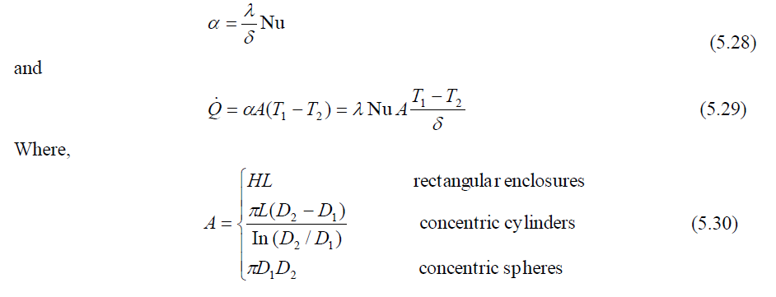
2-5.2 : Natural Convection inside Enclosures Contd.
Simple empirical correlations for the Nusselt number for various enclosures are given in Table 12.
Once the Nusselt number is available, the heat transfer coefficient and the rate of heat transfer through the enclosure can be determined from:

Slide 44
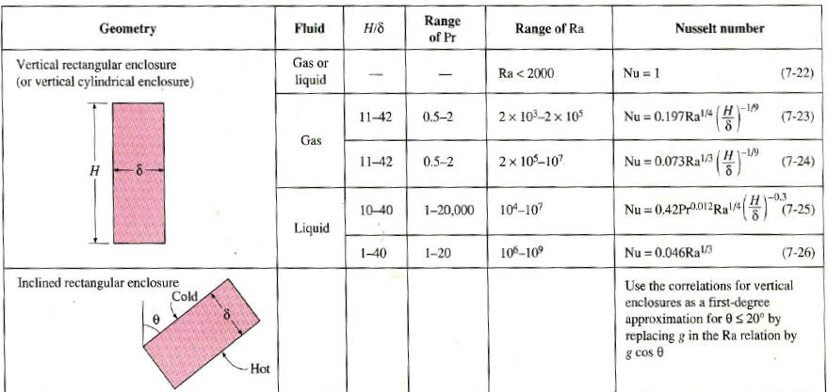
Natural convection correlation in enclosures
Table 12
Empirical correlations for the average Nusselt number for natural convection in enclosures (the characteristic length δ is as indicated on the respective diagram)

Slide 45
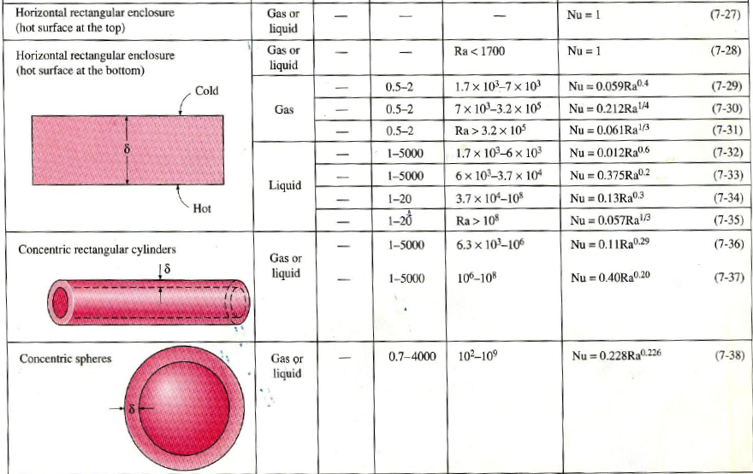
Natural convection correlation in enclosures contd.
Table 12 continued ; Empirical correlations for average Nusselt number for natural convection inside enclosures

Slide 46
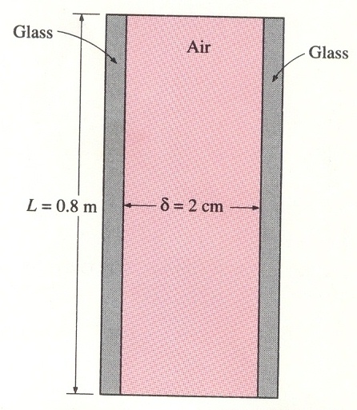
Worked Example 5.5 : Heat loss through a Double-Pane Window
Question:
The vertical 0.8-m-high, 2-m-wide double pane window shown in Figure 71 consists of two sheets of glass separated by a 2-cm air gap at atmospheric pressure. If the glass surface temperatures across the air gap are measured to be 12ºC and 2ºC, determine the rate of heat transfer through the window.
Figure 71

Slide 47
Solution: Worked Example 5.5 Contd.
Assumptions:
(1) Steady operating conditions exist.
(2) Air is an ideal gas.
(3) The local atmospheric pressure is 1 atm.
Properties: The properties of air at the film temperature of
λ = 0.0246 W/mºC Pr = 0.717 ν = 1.40 x 10⁻⁵m²/s
β = 1/T_{av} = 1/280 K = 0.00357 K⁻¹
Analysis:
We have a rectangular enclosure filled with air. The characteristic length in this case is the distance between the two glasses, δ = 0.02m. Then, the Rayleigh number becomes:

Slide 48
Solution: Worked Example 5.5 End.
Then, the natural convection Nusselt number in this case can be determined from Table 12 to be
Then, A = H x L = (0.8 m)(2 m) = 1.6 m²
And
Therefore, heat will be lost through the window at a rate of 25.9 W

Slide 49
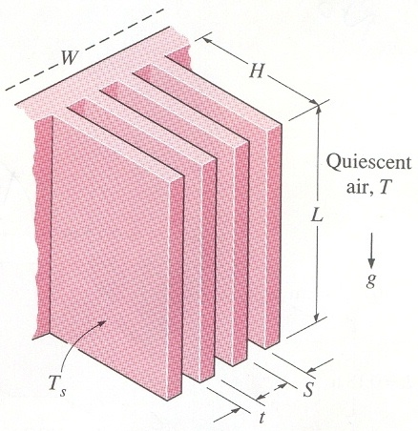
2-5.3: NATURAL CONVECTION FROM FINNED SURFACES
Selecting a heat sink for a particular application;
There is always the question of whether to select one with closely packed or widely spaced fins for a given base area.
A heat sink with closely packed fins will have greater surface area for heat transfer but a smaller heat transfer coefficient because of the extra resistance the additional fins will introduce to fluid flow through the inter-fin passages.
A heat sink with widely spaced fins, on the other hand, will have a higher heat transfer coefficient by a smaller surface area.
Therefore, there must be an optimum spacing that maximises the natural convection heat transfer from the heat sink for a given base area WL, where W and L are the width and height of the base of the sink, respectively, as shown in Figure 72 below.

Slide 50


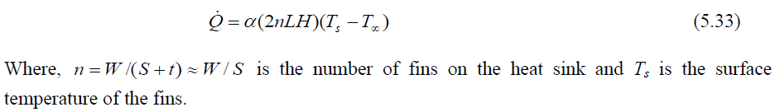
2-5.3: NATURAL CONVECTION FROM FINNED SURFACES
When the fins are essentially isothermal and the fin thickness t is small relative to the fin spacing S, the optimum fin spacing for a vertical heat sink is determined by Bar-Cohen and Rohsenow to be
Where, the fin length L in the vertical direction is taken to be the characteristic length in the evaluation of the Rayleigh number. The heat transfer coefficient for the optimum spacing case was determined to be
Then the rate of heat transfer by natural convection from the fins can be determined to be

Slide 51
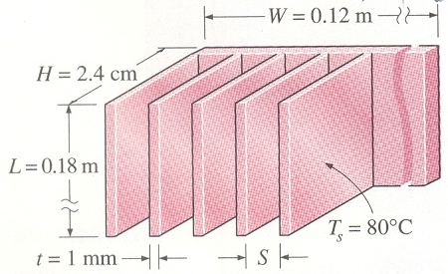
Worked Example 5.6 : Heat loss from the Ducts of a Heating system
Question:
A 12-cm-wide and 18-cm-high vertical hot surface in 25 ºC air is to be cooled by a heat sink with equally spaced fins of rectangular profile (Figure 73). The fins are 0.1 cm thick and 18 cm long in the vertical direction and have a height of 2.4 cm from the base. Determine the optimum fin spacing and the rate of heat transfer by natural convection from the heat sink if the base temperature is 80 ºC.
Figure 73

Slide 52
Solution: Worked Example 5.6 Contd.
Assumptions:
(1) Steady operating conditions exist.
(2) Air is an ideal gas.
(3) The local atmospheric pressure is 1 atm.
(4) The thickness t of the fins is very small relative to the fin spacing S so that Equations 5.31 and 5.32 for optimum fin spacing are applicable.
Properties: The properties of air at the film temperature of
λ = 0.0279 W/mºC Pr = 0.709 ν = 1.82 x 10⁻⁵m²/s
β = 1/T_{f} = 1/325.5 K = 0.003072 K⁻¹
Analysis:
The characteristic length in this case is the length of the fins in the vertical direction, which is given to be L = 0.18 m. Then, the Rayleigh number becomes

Slide 53
Solution: Worked Example 5.6 End.
The optimum fin spacing is determined from Equation 5.31 to be
This is about 7 times the thickness of the fins. Therefore, the assumption of negligible fin thickness in this case is acceptable for practical purposes. The number of fins and the heat transfer coefficient for this optimum fin spacing case are:
Then the rate of heat transfer from the fins by natural convection becomes;

Slide 54
2-5.4:COMBINED NATURAL AND FORCED CONVECTION
For a given fluid, it is observed that the parameter Gr/Re² represents the importance of natural convection relative to forced convection.
The convection heat transfer coefficient is a strong function of the Reynolds number, Re, in forced convection and the Grashof number, Gr, in natural convection.
Natural convection is negligible when Gr/Re² < 0.1, forced convection is negligible when Gr/Re² > 10, and neither is negligible when 0.1 < Gr/Re² < 10. Therefore, both natural and forced convection must be considered in heat transfer calculations when the Gr and Re² are of the same order of magnitude (one is within a factor of 10 times the other). Forced convection is small relative to natural convection only in the rare case of extremely low forced flow velocities.
Note:
The presence of a temperature gradient in a fluid in a gravity field always gives rise to natural convection currents, and thus heat transfer by natural convection. Therefore, forced convection is always accompanied by natural convection. Natural convection can however be ignored when high fluid velocities are involved.

Slide 55
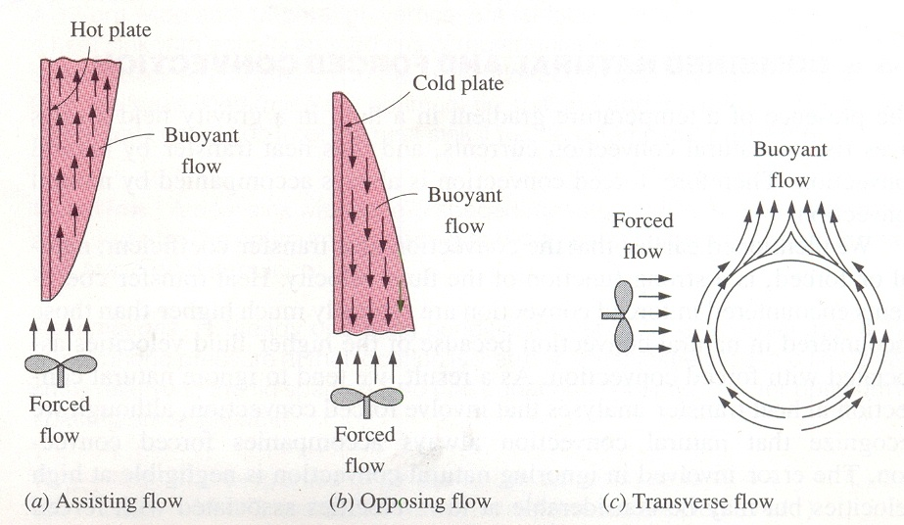
2-5.4:COMBINED NATURAL AND FORCED CONVECTION
Natural convection may help or hurt forced convection heat transfer, depending on the relative directions of buoyancy-induced and the forced convection motions (Figure 74)
Figure 74: Buoyancy induced and forced convection motions

Slide 56
2-5.4:COMBINED NATURAL AND FORCED CONVECTION
ASSISTING FLOW
The buoyant motion is in the same direction as the forced motion. Therefore, natural convection assists forced convection and enhances heat transfer. An example is upward forced flow over a hot surface.
OPPOSING FLOW
The buoyant motion is in the opposite direction to the forced motion. Therefore, natural convection resists forced convection and decreases heat transfer. An example is upward forced flow over a cold surface.
TRANSVERSE FLOW
In transverse flow, the buoyant motion is perpendicular to the forced motion. Transverse flow enhances fluid mixing and thus enhances heat transfer. An example is horizontal flow over a hot or cold cylinder or sphere.

Slide 57
2-5.4:COMBINED NATURAL AND FORCED CONVECTION
Combined natural and forced convection heat transfer is not obtained merely by adding the contributions of natural and forced convection in assisting flows and subtracting them in opposing flows. A review of experimental data suggests a correlation of the form:
Nu_{forced} and Nu_{natural} are determined from the known correlations of pure forced and pure natural convection, respectively.
The plus sign is used for assisting and transverse flows and the minus sign is used for opposing flows.
The value of the exponent n varies between 3 and 4, depending on the geometry involved. It is observed that n = 3 correlate experimental data for vertical surfaces as well. Larger values of n = 4 are better suited for horizontal surfaces.
The choice of whether to utilise natural or forced convection in the cooling of equipment depends on the maximum allowable operating temperature.
For very-high-power-output devices, even forced convection may not be sufficient to limit the operating temperature and boiling and condensation may be employed to take advantage of the very high heat transfer coefficients associated with phase change processes.

Slide 58
2-5.4:COMBINED NATURAL AND FORCED CONVECTION
A summary of combined free and forced convection effects in tubes has been given by Metais and Eckert (1964)
Figure 75 represents the regimes for combined convection in vertical tubes.
Figure 76 represents the regimes for combined convection for flow in horizontal tubes.
The applicable range of figures 75 and 76 is for
Brown and Gauvin (1965) have developed a better correlation for the mixed convection laminar flow region which is preferred over the relation by Oliver provided in figure 76 as;
Where μ_{b} is evaluated at the bulk temperature and μ_{w} is evaluated at the surface temperature of the tube wall. Note that the Graetz number is defined as;

Slide 59
2-5.4:COMBINED NATURAL AND FORCED CONVECTION
Figure 75: Regimes of free, forced and mixed convection for flow through vertical tubes according to Metais and Eckert

Slide 60
2-5.4:COMBINED NATURAL AND FORCED CONVECTION
Figure 76: Regimes of free, forced and mixed convection for flow through Horizontal tubes according to Metais and Eckert

Slide 61
Worked Example 5.7 : Mixed Convection Heat Transfer
Question:
Air at 1 atm and 27 °C is forced through a horizontal 25mm diameter tube at an average velocity of 30 cm/s. The tube wall is maintained at a constant temperature of 140 °C. Calculate the heat transfer coefficient for this situation if the tube is 0.4 m long.
Solution:
For this calculation we evaluate properties at the film temperature:
Let us take the bulk temperature to be 27 °C for evaluating μ_{b}; then

Slide 62
Solution to Worked Example 5.7 Contd.
The significant parameters are calculated as;
According to figure 76, the mixed convection flow regime is encountered. Thus we must use equation 5.35. The Graetz and Nusselt number are calculated as

Slide 63
Solution to Worked Example 5.7 End.
The average heat transfer coefficient is then calculated as
It is interesting to compare this value with that which would be obtained for strictly laminar forced convection. The Sieder – Tate relation applies, so that
Thus there would be an error of – 41 percent if the calculation were made strictly on the basis of laminar forced convection.
Individual/ Group Discussion Problems: Tutorial Problems Questions 11, 12, 26, 27, 28, 29, 30, 31.

Slide 64
Example on combined natural and forced convection heat transfer problem
Example 4.6 Heat Transfer in the Presence of Assisting and Opposing Flows
A 0.2 m x 0.2 m vertical plate has a surface temperature that is maintained at 40 ⁰C. Air at 20 ⁰C is flowing in parallel over the plate with a velocity of 0.4 m/s. Determine the Nusselt number for both assisting flow and opposing flow (Figure 4.1).
SOLUTION Air is flowing over a vertical plate. Nusselt numbers for both assisting and opposing flows are to be determined.
Assumptions 1 steady operating condition exists. 2. Properties are constant.
3 The surface temperature is constant. 4 Air is an ideal gas. 5 Heat transfer by radiation is negligible.
Properties The properties of air (1 atm) at 30 ⁰C are k = 0.02588 W/m.K, = 1.608x10⁻⁵ m²/s, and Pr = 0.7282 (From Tables). Also, = 1/T_{f} = 0.0033 K–1.

Slide 65
Analysis The Reynolds and Grashof numbers are evaluated as follows:
Re =VL_{c} / = (0.4 m/s) x (0.2 m)/(1.608 x10⁻⁵ m²/s) = 4975
Gr_{x} = g β (T_{s} – T)L_{c}³/ ² =( 9.81 m/s²)(0.0033 K⁻¹)(40 – 20)K(0.2 m)³/(1.608x 10⁻⁵) m⁴/s²= 2.003 x 10⁷
Gr/Re² = 2.003x10⁷/(4975)² = 0.809 Note 0.1<Gr/Re²<10, hence natural and forced convection are both significant.
Nu _{natural} = 0.59 Ra^{1/4} = 0.59(2.003x10⁷x 0.7282)^{1/4} =36.46
Nu _{forced}= 0.664Re^{0.5}Pr^{1/3}= 0.664 (4975)^{0.5}(0.7282)^{1/3} =42.14
For assisting flow, Nu _{combined}= (Nu³_{natural} +Nu³_{forced})^{1/3}= (36.46³ +42.14³)^{1/3}= 49.8
For opposing flow, Nu _{combined}= (Nu³_{forced} -Nu³_{natural})^{1/3}= (42.14³ – 36.46³)^{1/3}= 39.8
Note we dealt with vertical plate so n = 3 in the correlation used to evaluate the combined Nusselt number

